Slide 1
MS Power BI
Notes:
This presentation was automatically generated by PowerPoint Copilot based on content found in this document: https://trainingcopilot-my.sharepoint.com/personal/trainer10_train-copilot_com/_layouts/15/Doc.aspx?sourcedoc=%7B97D8090D-4B91-4B2B-AC0D-F8440E456E99%7D&file=Curriculum%20-%20Power%20BI%20-%20Oct%202024.docx&action=default&mobileredirect=true&DefaultItemOpen=1 AI-generated content may be incorrect.

Slide 2
OUTLINE
Introduction to Power BI
Loading Data and Templates
Data Modeling and Data Preparation
Visualizations in Power BI
Advanced Features for Interactivity
DAX (Data Analysis Expressions)
Security and Optimization
Publishing and Sharing Reports
Practice and Exercises
Notes:
Agenda * Introduction to Power BI * Demo Reports * Load Data Source * Power BI Report Templates * Power BI Applications * Data Modeling * Explore the Report View * Table * Table with Field Parameters * Matrix * Slicer - Category * Slicer – Data * Sync Slicers across Pages * Cards * Bookmarks and Page Navigators * Pie, Donuts and Tree Map * Clustered Column / Bar Chart * Line Chart and Forecasting * Practice Visualizations * Map Visualisations * Ribbon, Waterfall and Funnel Charts * Publish Reports * Dashboards * DAX Formulas - An Introduction * DAX - New Tables * DAX - New Columns * DAX - New Measure * DAX - More with Tables * New Measures with Variables * Row-Level Security * Data Transformation using Power Query * Connecting to SQL Server * Data Connectivity Mode: Import * Benefits of Import Mode * Limitations of Import Mode * Direct Query Mode * SQL Query Example for Direct Query Mode * Benefits of Direct Query Mode * Limitations of Direct Query Mode * Using Native Queries * Connecting to OneDrive * Connecting to an API * Changing the Data Source in Power BI * Project

Slide 3
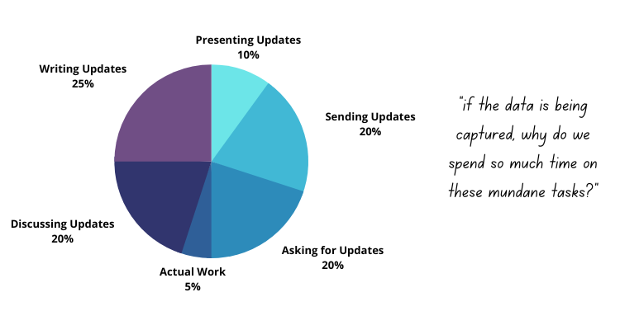
Introduction to Power BI
What is Power BI?
Business intelligence tool for reporting insights
Customizable visualizations and dashboards
Accessible on any desktop or mobile device
Power BI and Microsoft Fabric
Part of Microsoft Fabric as of May 2023
Microsoft Fabric offers a comprehensive data solution
Includes seven key workloads for various data tasks
Who Can Use Power BI?
No need to be a coding engineer or data scientist
Experience with data, Excel, and formulas is sufficient
Notes:
Power BI is a business intelligence tool for reporting insights with customizable visualizations and dashboards. It's part of Microsoft Fabric, offering a comprehensive data solution. Anyone with experience in data, Excel, and formulas can use Power BI. Original Content: Introduction to Power BI What is Power BI? Power BI is a business intelligence tool that allows you to effectively report insights through easy-to-use customizable visualizations and dashboards. Power BI reports and dashboards can be accessed on any desktop or mobile device. As of May 2023, Power BI is part of Microsoft Fabric. Microsoft Fabric offers an all-encompassing solution for your data needs, acting as a one-stop platform for storing, managing, and analyzing data efficiently. Within its suite, it features seven key workloads tailored for various data tasks, including: Download Power BI Download Link Why Use Power BI? Who Can Use Power BI? The good news is that you do not need to be a coding engineer or a data scientist to use Power BI. If you have experience working with data, Excel, and formulas within Excel, you are well-equipped to learn Power BI.

Slide 4
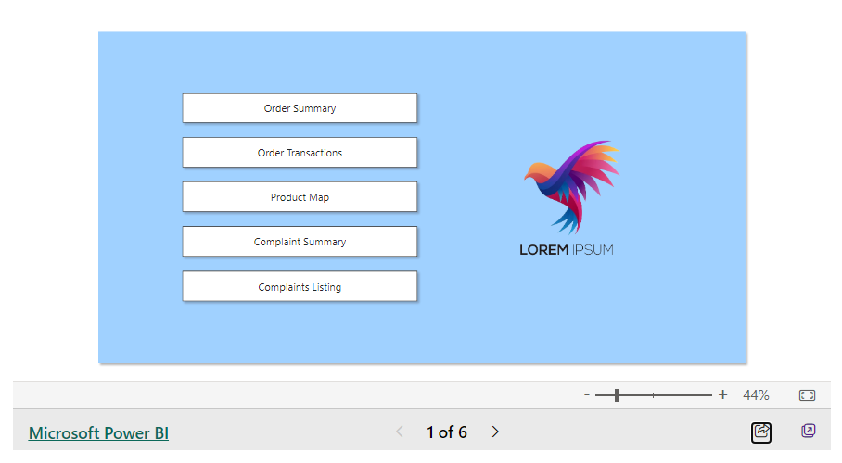
Demo Reports
Sales Analytics
Analyzing sales data to improve performance
HR Analytics
Analyzing human resources data to improve employee management
Notes:
Sales analytics involves analyzing sales data to enhance performance, while HR analytics focuses on human resources data to improve employee management. Original Content: Sales Analytics HR Analytics

Slide 5
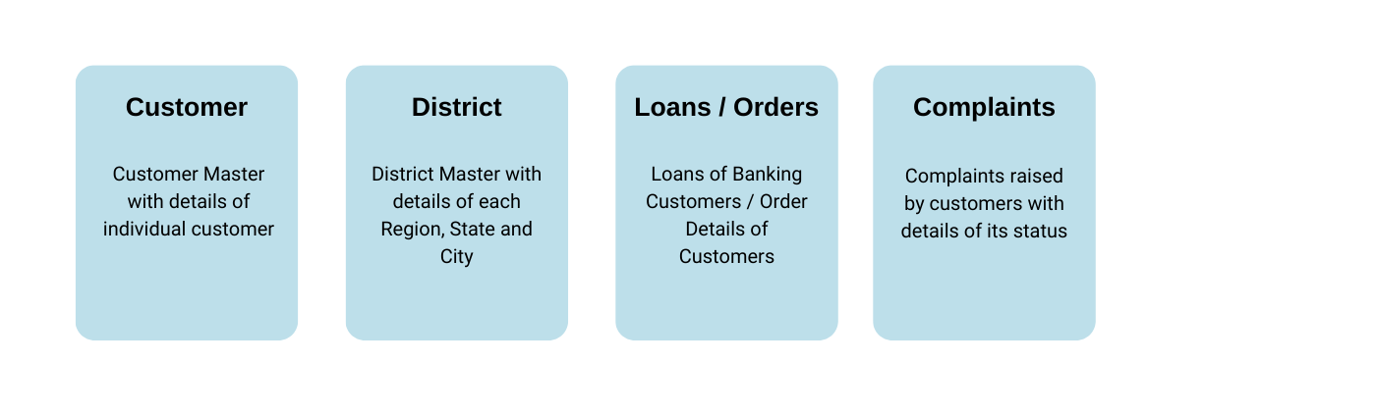
Load Data Source
Data Source Support
Power BI supports over 115 data sources
Data sources are divided into six categories
Sample Dataset
Using a Sample Excel Dataset of HomeWork Station Supply
Guides instructions in the course
Query Limits
Query execution time and memory usage limits vary based on hosting location
Power BI Desktop allows alignment with these limits
Settings accessible under Options > Report settings
Notes:
Power BI supports over 115 data sources in six categories. We'll use a Sample Excel Dataset of HomeWork Station Supply for this course. Query execution time and memory usage limits vary based on the hosting location, and Power BI Desktop allows alignment with these limits under Options > Report settings. Original Content: Load Data Source Data Source Support Power BI offers support for more than 115 data sources, divided into six categories. Microsoft Documentation Sample Dataset In this course, we will be using a Sample Excel Dataset of HomeWork Station Supply to guide our instructions. Download Demo Dataset Get Data Inspect Data Query Limits Within the Power BI Service, query execution time and memory usage limits vary based on the hosting location of a report's data. Power BI Desktop allows you to align with these limits in anticipation of where your data will be hosted in the Service. These settings are accessible under Options > Report settings.

Slide 6
Power BI Report Templates
Definition of Power BI Report Templates
Pre-designed files with report layouts, visual elements, themes, and data model structures
Exclude underlying data
Purpose and Use
Allow creation of standardized reports
Reusable across different datasets
Contents of a .pbit file
Structure and formatting of a Power BI report
Does not include data
Download Templates
Microsoft provides standard templates
Link to download: https://learn.microsoft.com/en-us/power-bi/create-reports/sample-datasets#download-original-sample-pbix-power-bi-files
Notes:
Power BI report templates are pre-designed files that include report layouts, visual elements, themes, and data model structures but exclude the underlying data. They allow users to create standardized reports that can be reused across different datasets. Microsoft provides standard templates for download. Original Content: Power BI Report Templates Power BI report templates are pre-designed files that include report layouts, visual elements, themes, and data model structures but exclude the underlying data. These templates are a powerful feature in Power BI, allowing users to create standardized reports that can be reused across different datasets. In this chapter, we will provide detailed instructions on how to create, use, and customize Power BI report templates, along with examples, benefits, and limitations of this functionality. What is a Power BI Report Template? A Power BI report template, or a .pbit file, contains the structure and formatting of a Power BI report without including the data itself. It stores the following: Download Templates Microsoft has provided a list of standard templates that you can download. https://learn.microsoft.com/en-us/power-bi/create-reports/sample-datasets#download-original-sample-pbix-power-bi-files Steps to Create a Power BI Report Template Benefits of Using Power BI Report Templates Limitations of Power BI Report Templates Best Practices for Power BI Report Templates

Slide 7
Power BI Applications
Feature | Power BI Desktop | Power BI Service
Availability | Free desktop application | Cloud-based service
Report Authoring | Yes | Yes
Data Transformation | Yes | Limited
Data Modeling | Yes | Limited
Analytical Features | Yes | Limited
Sharing and Collaboration | No (requires Pro License for sharing) | Yes (requires Pro License)
License Requirement | Free | Pro License for sharing and collaboration
Power BI Desktop
Free desktop application for report authoring and publishing
Provides tools for data transformation, modeling, and analysis
Ideal for creating comprehensive reports on local machines
Power BI Service
Cloud-based version of Power BI
Features for report editing, dashboard creation, and collaboration
Allows sharing of reports and dashboards within the organization
Power BI Mobile
Mobile app for authoring, viewing, and sharing reports
Available for iOS and Android devices
Power BI Report Builder
Notes:
Power BI offers various applications to cater to different needs. Power BI Desktop is ideal for creating detailed reports on your local machine. Power BI Service is cloud-based, allowing for collaboration and sharing. Power BI Mobile lets you access reports on the go, and Power BI Report Builder is perfect for creating paginated reports for printing or PDFs. Original Content: Power BI Applications Power BI Desktop Power BI Desktop is a free desktop application that provides tools for report authoring and publishing with data transformation, data modeling, and analytical features. It is ideal for creating comprehensive reports and performing complex data transformations and modeling on your local machine. Power BI Service Power BI Service is the cloud-based version of Power BI that offers features for report editing, dashboard creation, and collaboration. You can share your reports and dashboards with others in your organization. Power BI Desktop vs Power BI Service Power BI Mobile Power BI Mobile is a mobile app that allows you to author, view, and share reports on the go. It is available for both iOS and Android devices, ensuring you can access your data and insights anytime, anywhere. Power BI Report Builder Power BI Report Builder is a desktop application used for creating paginated reports, which are ideal for printing or generating PDFs. These reports can also be built using Power BI Service. Power BI Report Builder offers more features and flexibility for creating detailed and formatted reports.

Slide 8
Data Modeling
Table Properties
Assign the Key column for each table from Model View
Establishes the Primary Key for every table
Data Category for Fields
Specify data category for a column
Power BI supports 12 Data Categories divided into 3 Groups
Summarize Fields
Choose how to summarize numeric data
Sales column can be summarized to show the sum
District_code can be left uncategorized
Manage Relationships
Azure Synapse for big data and analytics
Table Name | Key Column
customer | client_id
category | category_id
district | district_code
order | order_id
complaints | complaint_id
Notes:
Data modeling in Power BI involves assigning Key columns to establish Primary Keys, specifying data categories for columns, summarizing numeric data, and managing relationships using Azure Synapse for big data and analytics. Original Content: Data Modeling Table Properties From the Model View, assign the Key column for each table. This action establishes the Primary Key for every table in the model. Data Category for Fields You can specify the data category for a column so Power BI Desktop knows how it should treat its values when in a visualization. It can be specified either from Model View or Report View. As of May 2023, Power BI supports 12 Data Categories divided into 3 Groups. Summarize Fields For any column of numeric data that is contained in a table, there is the option to choose how to summarize this data. For example, the Sales column in the order table can be summarized to show the sum in your visualizations. However, district_code in the district table does not require to be summarized and can be left uncategorized. Performing this one-time activity for all your loaded tables can save time and resources while creating your reports. Manage Relationships Azure Synapse for big data and analytics

Slide 9
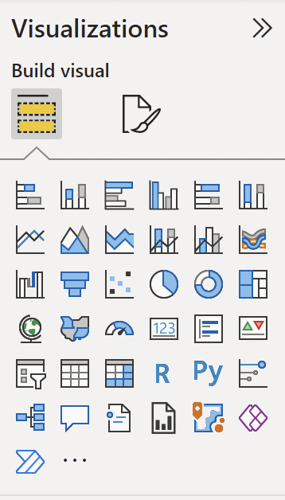
Explore the Report View
Report View in Power BI
Design and build interactive reports
Add various visualizations to the report canvas
Getting Started
Click on the Visualizations pane
Access a variety of visualizations and customization options
Visualizations in Power BI
30 built-in visualizations as of July 2024
Option to add custom visualizations from the marketplace
Enhancements and new capabilities for better data visualization and analysis
Navigation Panes
Azure Data Explorer for real-time analytics on large volumes of data
Notes:
In Power BI's Report View, you can design and build interactive reports by adding various visualizations. Start by clicking on the Visualizations pane to access customization options. As of July 2024, Power BI offers 30 built-in visualizations and the option to add custom ones. Use Azure Data Explorer for real-time analytics on large data volumes. Original Content: Explore the Report View Reports in Power BI are created in the Report View. This is where you design and build your interactive reports by adding various visualizations to the report canvas. Getting Started To start building your report, click on the Visualizations pane, located on the right-hand side of the screen. This pane provides access to a variety of visualizations and customization options. As of July 2024, Power BI offers 30 built-in visualizations, along with the option to add custom visualizations from the marketplace. This update includes various enhancements and new capabilities to help users better visualize and analyze their data (Microsoft Learn) (Power BI Toolkit). Navigation Panes Azure Data Explorer for real-time analytics on large volumes of data

Slide 10

Table
Display Sales by Region
Use a table visualization
Showcase the top 10 customers
Arrange customers in descending order by sales amount
Activity
Utilize a table visualization
Showcase the top 10 customers
Arrange customers in descending order by sales amount
Hint: Use the Top N Filter from the Filters pane
Notes:
To illustrate table visualization, display sales by region using a table. Showcase the top 10 customers in descending order by sales amount. Use the Top N Filter from the Filters pane. Original Content: Table To illustrate the application of table visualization, let's examine the following use case. Display Sales by Region Activity Utilize a table visualization to showcase the top 10 customers, arranged in descending order according to their sales amount. Hint: Use the Top N Filter from the Filters pane.

Slide 11
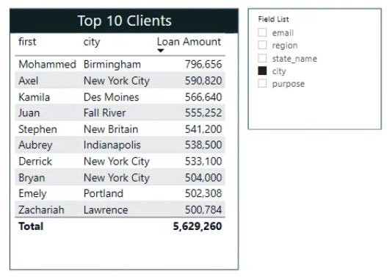
Table with Field Parameters
Introduction to Field Parameters
Allows dynamic change of measures or dimensions
Enhances report readability
Enables customized analysis
Creating a Field Parameter
Provide a name for the parameter
Select fields such as email, region, state, city, and purpose
Editing Field Parameters
Manually edit the DAX formula
Learn more about DAX formulas later in the course
Example Field List
Field List = {(
Notes:
Power BI supports Field Parameters, allowing dynamic changes in measures or dimensions. Create a parameter by naming it and selecting fields like email, region, state, city, and purpose. Edit parameters by modifying the DAX formula. Refer to Microsoft Documentation for limitations. Original Content: Table with Field Parameters Power BI supports Field Parameters, allowing users to dynamically change the measures or dimensions analyzed within a report. This feature enhances report readability by enabling readers to explore and customize their analysis by selecting various measures or dimensions of interest. Create a Field Parameter To begin, provide a name for the parameter and select the fields you wish to use. In this example, the chosen fields include email, region, state, city, and purpose. Edit the Field Parameters To modify the field parameters, you need to manually edit the DAX formula. You will learn more about DAX formulas later in the course. Field List = { ("email", NAMEOF('customer'[email]), 0), ("region", NAMEOF('district'[region]), 1), ("state_name", NAMEOF('district'[state_name]), 2), ("city", NAMEOF('district'[city]), 3), ("purpose", NAMEOF('loan'[purpose]), 4) } Limitations Field parameters do have some limitations. For more details, refer to the Microsoft Documentation. https://learn.microsoft.com/en-us/power-bi/create-reports/power-bi-field-parameters#limitations

Slide 12
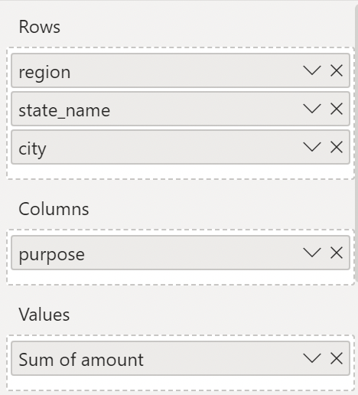
Matrix
Use Case for Matrix Visualization
Display Loans Disbursed by Region, State, and City
Loans categorized by Purpose
Activity Instructions
Add the field 'gender' from the customer table as an additional column
Toggle between Row and Column to use the Drill Down feature
Power BI Accessibility
No need to be a coding engineer or data scientist
Experience with data, Excel, and formulas within Excel is sufficient
Notes:
Matrix visualization in Power BI can display loans disbursed by region, state, and city, categorized by purpose. Add the 'gender' field from the customer table and use the Drill Down feature. Power BI is accessible to those with experience in data, Excel, and formulas. Original Content: Matrix To illustrate the application of Matrix visualization, let's examine the following use case. Display Loans Disbursed by Region, State and City categorized by Purpose Activity Add the field gender from the customer table as an additional column to the matrix. Toggle between Row and Column to use the Drill Down feature The good news is that you do not need to be a coding engineer or a data scientist to use Power BI. If you have experience working with data, Excel, and formulas within Excel, you are well-equipped to learn Power BI.

Slide 13
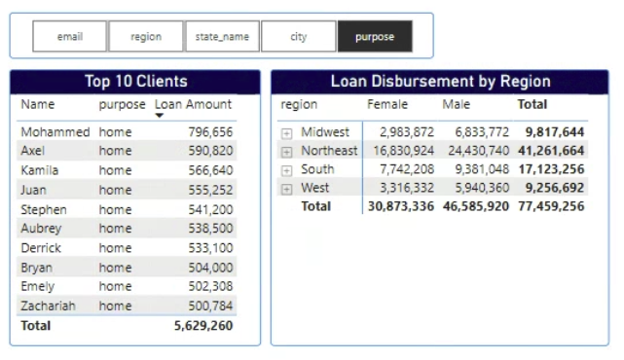
Slicer - Category
Adding a Slicer with Loan Purpose
Add the purpose field from loan to the Slicer
Filter all visualizations on the report page by selecting any category on the Slicer
Formatting the Slicer
Recommended options include Slicer Settings - Options - Style
Slicer Settings - Selection - Select All
Testing Interaction
Selecting a value from the slicer filters the previously created Table and Matrix
In Power BI, this is referred to as Interactions
Editing Interactions
Enable Editing by clicking the format icon and enabling Edit Interactions
Toggle between the None and Filter buttons on the visualizations to control interaction
Notes:
To use the Slicer visualization in Power BI, add the purpose field from loan. Format the Slicer with recommended options. Test interactions by selecting values to filter visualizations. Edit interactions by enabling Edit Interactions and toggling between None and Filter buttons. Original Content: Slicer - Category The slicer visualization can be used with Text (Category), Numbers or Date Fields. In this chapter, we will explore how to use the Slicer Visualisation with a text field. Use Case: Add a Slicer with the Loan Purpose Add field to the Slicer You can add multiple data fields to the Slicer. To get started, add the purpose field from loan Selecting any of the categories on the Slicer will filter all the existing visualizations on the report page. Format Slicer Recommended Options Slicer Settings - Options - Style Slicer Settings - Selection - Select All Test Interaction Selecting a value from the slicer filters the previously created Table and Matrix in this course. In Power Bi, this is referred to as Interactions. Edit Interactions You may choose to Edit the Interactions between visualizations. To enable Editing, click the format icon and enable Edit Interactions. By Default all visualizations Interact with each other. Toggle between the None and Filter Switch between the "None" and "Filter" buttons on the visualizations to toggle the interaction of a selected visualization with others.

Slide 14
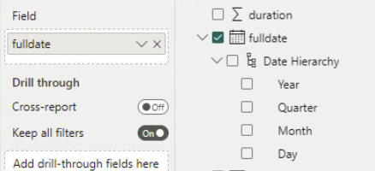
Slicer – Data
Adding Date Field to Slicer
Insert date field directly without choosing hierarchy
Other visualizations filter based on Date selection
Formatting Slicer with Date
Choose to add Date with Date Hierarchy
Select individual child options like Year, Quarter, Month, or Day
Notes:
The slicer visualization can be used with date fields. You can add a date field directly or with a hierarchy. Other visualizations will filter based on the date selection. Original Content: Slicer – Data The slicer visualization can be used with Date Fields. User Case: Add a Slicer for the fulldate field from the loan dataset Add Date Field to Slicer You can insert the date field into the slicer directly, without choosing a specific hierarchy such as Year, Quarter, Month, or Day. The other visualizations (Eg: Table and Matrix) will filter based on the Date selection. Format Slicer with Date Add Date with Hierarchy You can instead choose to add Date with the Date Hierarchy or individual child options in the Hierarchy like Year, Quarter, Month or Day.

Slide 15
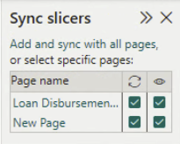
Sync Slicers across Pages
Enable Slicer Sync
Make a Slicer created on one page visible on all pages
Use a single slicer to filter visualizations on all or selected pages
Activate Sync for Slicer from the View tab
Activate Sync for Slicer
First column: name of pages in PowerBi Report
Second column: 'sync' column, link slicers by checking this
Third column: indicates whether the slicer is displayed
Compatible with built-in Slicer visualization
Does not function with custom visual slicers
Apply all Slicers
Make multiple selections across various slicers without immediate refresh
Notes:
Sync Slicers across pages in Power BI to make a slicer created on one page visible on all pages. Activate sync from the View tab. Use the 'Apply all Slicers' button to make multiple selections without immediate refresh, accessible from the Optimize Tab. Original Content: Sync Slicers across Pages Enable Slicer Sync Slicer Sync enables you to: Make a Slicer created on one page visible on all pages in your report Use a single slicer to filter of visualizations on all or selected report pages To enable Slicer Sync, from the View tab click the Sync Slicers icon. Activate Sync for Slicer The first column contains the name of pages in your PowerBi Report. The second column is the ‘sync’ column, if none of these are checked, the slicers will continue to function independently of each other. If you check this, the slicers are essentially linked, and a change on one page filters the visualizations of other pages. The third column indicates whether the slicer is being displayed. Slicer sync is compatible with the built-in Slicer visualization. However, syncing across pages does not yet function with custom visual slicers, such as the Chiclet Slicer or other visualizations like column or pie charts. Apply all Slicers March 2023 Update The 'Apply all slicers' functionality provides a convenient way to make multiple selections across various slicers without the immediate refresh of report visuals. This allows for a more seamless experience as you can choose the desired slicer values without interruption. Once you have finalized your selections, simply click on the 'Apply all Slicers' button to update the report visualizations with the new criteria. The Apply all Slicers button is accessible from the Optimize Tab. The use of this feature is a recommended Query Reduction method.

Slide 16
Cards
Card | Field
Loan Amount Disbursed | Sum of Loan Amount
Loan Accounts | Count of loan id
Loan Customers | Distinct Count of client id from loan table
Card Visualization
Displays a single aggregate value
Example: Sum of Loans Disbursed
Multi-Row Card Visualization
Displays multiple aggregate values
Example: Count of Loan Accounts and Distinct Count of Loan Customers
Use Case for IT Professionals
Monitor system performance
Track software usage
Visualize network traffic data
Notes:
Power BI offers two card visualizations: single aggregate and multi-row. Single aggregate cards display one value, like the sum of loans disbursed. Multi-row cards show multiple values, such as the count of loan accounts and distinct loan customers. IT professionals can use these to monitor system performance, track software usage, and visualize network traffic data. Original Content: Cards Power BI offers two card visualizations: one with a single aggregate and another with multiple aggregates. In this chapter, we will delve into both options. Card Use Case: Show Sum of Loans Disbursed, Count of Loan Accounts and Distinct Count of Loan Customers Multi-Row Card IT Professionals: Monitor system performance, track software usage, and visualize network traffic data.

Slide 17
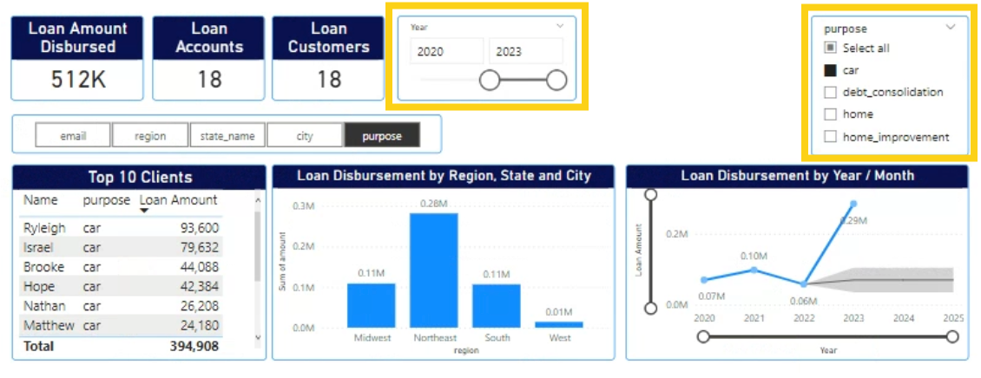
Bookmarks and Page Navigators
Bookmarks in Power BI
Save and recall the current state of a report page
Capture layout and filtering settings
Creating a Bookmark
Open the report page
Select 'Bookmarks' from the View tab
Use Case: Car Loans Disbursed (2020-2022)
Updating Bookmarks
Activity: Reset Bookmark
Bookmark and Page Navigators
Bookmark Navigator
Page Navigator
Notes:
Bookmarks in Power BI save and recall report states. Create bookmarks by selecting 'Bookmarks' from the View tab. Use cases include filtering visualizations for car loans. Update bookmarks to revise report states. Use navigators to construct efficient navigation experiences. Original Content: Bookmarks and Page Navigators Bookmarks in Power BI serve as a tool for saving and recalling the current state of a report page. They enable you to capture the layout and filtering settings of a report page, save them as a bookmark, and subsequently use it to revisit that precise state at a later time.. Creating a Bookmark To create a bookmark for a specific report page, first open that page. Then, from the View tab, select "Bookmarks." Use Case: Create a Bookmark that filters Visualizations for Car Loans Disbursed between 2020 to 2022 Filter the visualisations as per below illustration From the Bookmark tab, save the current state of the report by adding a New Bookmark Bookmarks can also be updated to revise the state of the report that it can reflect. Activity Create a Bookmark that will Reset the report to its original state Utilizing Power BI's integrated navigators, you can efficiently construct page and bookmark navigation experiences with minimal effort. These navigators save considerable time in developing and overseeing your page or bookmark navigation experiences. Bookmark Navigator On the Insert tab, select Buttons > Navigator > Bookmark navigator Page Navigator On the Insert tab, select Buttons > Navigator > Page navigator

Slide 18

Pie, Donuts and Tree Map
Pie Charts
Displays proportions of data
Example: Proportion of male and female clients
Donut Charts
Similar to pie charts but with a hole in the center
Treemaps
Displays hierarchical data
Example: Categorizes orders by subcategory within each category
Notes:
Pie charts, donut charts, and treemaps in Power BI help visualize proportions and hierarchies. Pie charts show data proportions, like male and female clients. Donut charts are similar but with a hole in the center. Treemaps display hierarchical data, such as categorizing orders by subcategory within each category. Original Content: Pie, Donuts and Tree Map Pie Charts, Donut Charts, and Treemaps in Power BI are useful for displaying proportions and hierarchies in your data, making it easier to understand at a glance. Pie Charts Objective: To create a pie chart that displays the proportion of male and female clients. Donut Chart Treemap Objective: To create a treemap that categorizes orders by subcategory within each subcategory.

Slide 19
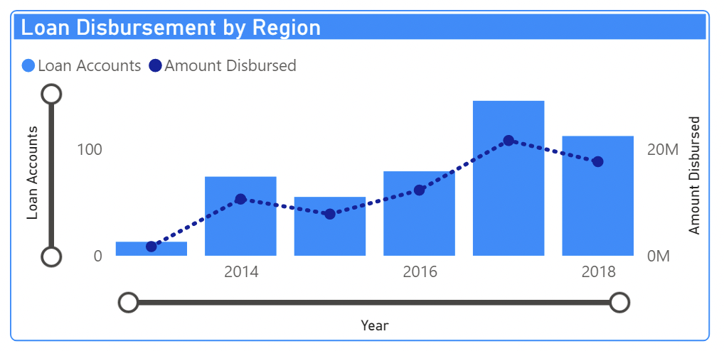
Clustered Column / Bar Chart
Commonly used for comparing specific values across categories
Alternative to a Matrix
Supports all Drill Down features
Use Case: Display Loan Disbursement by Region, State, and City
Effective for visualizing loan disbursement data
Activity: Create a Line and Clustered Column Chart
Displays data as specified
Load Data Source
Ensure data is correctly loaded for accurate visualization
Notes:
Clustered Column and Bar Charts are used to compare values across categories. They support Drill Down features and can replace a Matrix. For example, they can display Loan Disbursement by Region, State, and City. Ensure data is loaded correctly for accurate visualization. Original Content: Clustered Column / Bar Chart Bar and Column Charts are commonly used for comparing specific values across various categories. To illustrate the concept of a Clustered Bar Chart, we will discuss the following use case. These charts can be employed as an alternative to a Matrix, as it fully supports all Drill Down features. Use Case: Display Loan Disbursement by Region, State and City Activity Create a Line and Clustered Column Chart that displays as below Load Data Source

Slide 20
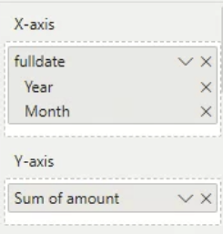
Line Chart and Forecasting
Line charts facilitate trend identification
Typically used over time
Example usage
Load data source
Notes:
Line charts help identify trends over time. For example, load a data source to illustrate their usage. Original Content: Line Chart and Forecasting Line charts facilitate the identification of trends, typically over time. To illustrate their usage, let's examine the following example. Load Data Source

Slide 21
Practice Visualizations
Card
Total Complaints
Orders with Complaints
Unresolved Complaints
Disputed Complaints
Table
Key 5 Reported Issues
Matrix
Complaint Count by Category and Subcategory
Bar Chart
Complaint Count by Region, Segment, and Category
Line Chart
Notes:
This slide provides an overview of complaint analysis. It includes total complaints, orders with complaints, unresolved complaints, and disputed complaints. Key reported issues are listed in a table. Complaint counts are categorized by category, subcategory, region, segment, and year, represented in various charts. Original Content: Card Total Complaints Orders with Complaints Unresolved Complaints Disputed Complaints Table Key 5 Reported Issues Matrix Complaint Count by Category and Subcategory Bar Chart Complaint Count by Region, Segment, and Category Line Chart Complaint Count by Year

Slide 22
Map Visualisations
Basic Map (Bubble Map)
Shows location and magnitude of sales across cities
Filled Map
Displays sales data by state with color intensity representing sales volume
ArcGIS Maps
Utilizes advanced geographic features like heat maps or multiple layers
Conclusion
Maps in Power BI provide spatial context to uncover regional trends
Each map type serves different visualization needs
Tips for Effective Map Visualizations
Ensure data quality, especially geographic data
Select map type to match data and story
Notes:
Power BI maps allow interactive geographic data visualization. Basic maps show sales locations, filled maps display state sales data, and ArcGIS maps offer advanced features. Ensure data quality, choose the right map type, and consider user interactivity for effective visualizations. Original Content: Map Visualisations Maps in Power BI allow users to visualize geographic data interactively, providing insights that are not possible with traditional charts. This tutorial will cover several types of map visualizations including the basic Map, Filled Map, and ArcGIS Map. Basic Map (Bubble Map) Objective: Show the location and magnitude of sales across different cities. Filled Map Objective: Display sales data by state, with color intensity representing the sales volume. ArcGIS Maps Objective: Utilize advanced geographic visualization features like heat maps or multiple layers. Conclusion Maps in Power BI offer dynamic and powerful ways to present geographic data, providing spatial context that helps to uncover regional trends and insights. Each map type serves different visualization needs, from simple point distribution to complex spatial analysis. Tips for Effective Map Visualizations Always ensure data quality, especially geographic data, as inaccuracies can mislead. Be mindful of the map type selection to match your data and the story you want to tell. Consider user interactivity—tool tips, drill-downs, and slicers enhance user engagement.

Slide 23
Ribbon, Waterfall and Funnel Charts
Transaction | Value Change | Description
Starting Balance | 10000 | (Starting point)
January Sales | 5000 | (Positive change)
February Returns | -700 | (Negative change)
March Advertising Expense | -1200 | (Negative change)
April New Product Launch | 4500 | (Positive change)
Net Profit | 17600 | (End Total calculated as Cumulative)
Ribbon Chart
Objective: Demonstrate sales trends over time by category
Waterfall Chart
Objective: Analyze cumulative effect of sequentially introduced values
Funnel Chart
Notes:
This slide covers three types of charts: Ribbon, Waterfall, and Funnel. The Ribbon Chart demonstrates sales trends over time by category. The Waterfall Chart analyzes the cumulative effect of sequentially introduced values. Lastly, the Funnel Chart is also mentioned. Original Content: Ribbon, Waterfall and Funnel Charts Ribbon Chart Objective: To demonstrate sales trends over time by category. Data Requirements: Waterfall Chart Objective: To analyze the cumulative effect of sequentially introduced positive or negative values. Data Requirements: Funnel Chart

Slide 24
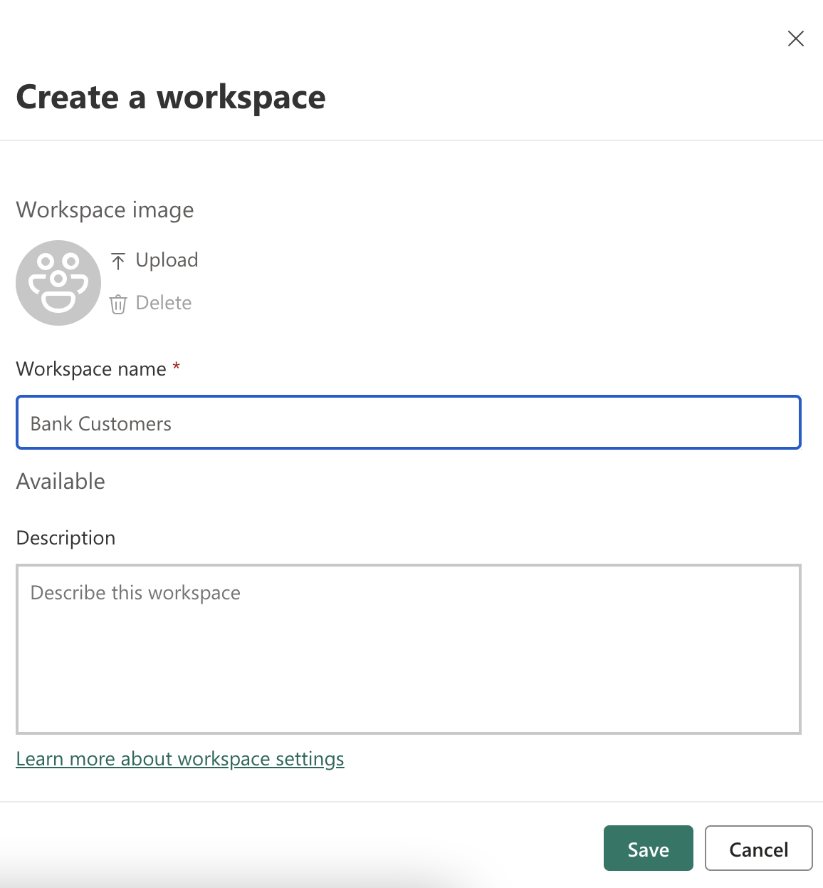
Publish Reports
Publish Reports
Power BI Pro License required
Free 60-Day Trial supports publishing
Create a Workspace
Collaborative environment for dashboards, reports, and datasets
Navigate to Power BI Service and create a new workspace
Define users and groups with access
Publish Reports and Datasets
Click Publish icon from Home tab
Datasets and reports visible in workspace
View reports on Mobile using Power BI App
Mobile Layout for Reports
Notes:
To publish reports in Power BI, a Pro License is needed. Create a workspace for collaboration, then publish reports and datasets. Use the mobile layout view to optimize reports for mobile devices by dragging visualizations to the layout. Original Content: Publish Reports You will need a Power BI Pro License to publish reports to the Power BI service. The Free 60-Day Trial supports report publishing. Create a Workspace Workspaces serve as collaborative environments where colleagues can create and organize collections of dashboards, reports, and datasets. Using your login credentials, navigate to Power BI Service Click Workspaces and select New Workspace. Under Advanced, you can define the organisation users and groups who will have access to this workspace Publish Reports and Datasets to Power BI Service From the Home tab, click the Publish icon and publish to the workspace you have created. Once published, your datasets and reports will be visible in the workspace of your Power BI Service account. The reports can also be viewed on Mobile using the Power BI App. Mobile Layout for Reports Power BI's mobile layout view is used to create views of report pages that are optimized for viewing on mobile devices. Mobile layout view is available in both Power BI Desktop and in the Power BI service. If you opt against creating a mobile layout for a report, visualizations will still be accessible on mobile devices through the standard report view. When creating Mobile Layouts, you will need to make one for each Page in your report From the Page Visuals Pane, click and Drag the Visualizations to the Mobile Layout.

Slide 25
Dashboards
Power BI Dashboard Overview
Single page canvas telling a story through visualizations
Contains only highlights of the story
Readers can view related reports for details
Dashboard Features
Pin visuals from several unrelated reports into one review
Available only in Power BI service
Requires Power BI Pro or Premium Per User (PPU) license
Pinning Reports to Dashboard
Pin entire report page as a Dashboard
Pin individual report visuals to a Dashboard
Cannot pin Slicers to a Dashboard
Capability | Dashboards | Reports
Pages | One page | One or more pages
Data sources | One or more reports and one or more datasets per dashboard | A single dataset per report
Drilling down in visuals | Only if you pin an entire report page to a dashboard. | Yes
Available in Power BI Desktop | No | Yes. You can build and view reports in Power BI Desktop.
Filtering | No. You can't filter or slice a dashboard. You can filter a dashboard tile in focus mode, but can't save the filter. | Yes. There are many different ways to filter, highlight, and slice.
Natural language queries (Q&A) | Yes | Yes, provided you have edit permissions for the report and underlying dataset.
Set alerts | Yes. Available for dashboard tiles in certain circumstances. | No
Subscribe | Yes. You can subscribe to a dashboard. | Yes. You can subscribe to a report page.
See dataset tables and fields | No. You can export data instead. | Yes
Notes:
A Power BI dashboard is a single-page canvas that tells a story through visualizations. It highlights key points and allows pinning visuals from unrelated reports. Available only in Power BI service, it requires a Pro or PPU license. You can pin entire report pages or individual visuals, but not Slicers. Original Content: Dashboards A Power BI dashboard is a single page, often called a canvas, that tells a story through visualizations. Because it's limited to one page, a well-designed dashboard contains only the highlights of that story. Readers can view related reports for the details. Dashboard allows you to pin visuals from several unrelated reports into one review. Dashboards are a feature of the Power BI service. They're not available in Power BI Desktop. You need a Power BI Pro or Premium Per User (PPU) license to create dashboards in workspaces. Dashboards vs Reports Pin an entire report page as a Dashboard Open a Published report and select Pin to a Dashboard from the Menu The entire report page is shown as a single Dashboard Tile that can be resized. All interactions between visualizations work in this format. Pin individual report visuals to a Dashboard As shown in the below illustration, you can pin individual tiles from unrelated reports to a Dashboard. You cannot pin Slicers to a Dashboard. Hover over any visualization and select Pin visual Similarly, you can add additional visualizations to the existing Dashboard

Slide 26
DAX Formulas - An Introduction
DAX Language Overview
Created for handling data models
Used in Microsoft Power BI and Power Pivot for Excel
Applications of DAX
Calculated Columns: Add columns for analysis or reporting
Measures: Create dynamic calculations based on filter context
Tables: Create new tables for summarized or specific data
Row-Level Security: Secure data for different viewers
Key DAX Formulas
USERELATIONSHIP, AVERAGE, AVERAGEA, AVERAGEX
COUNTA, COUNTAX, COUNTBLANK, COUNTROWS, COUNTX
DISTINCTCOUNT, DISTINCTCOUNTNOBLANK, MAX, MAXX, MIN, MINA
Notes:
DAX is a language for handling data models, used in Microsoft Power BI and Power Pivot for Excel. It helps create calculated columns, measures, tables, and implement row-level security. Key DAX formulas include USERELATIONSHIP, AVERAGE, COUNTA, DISTINCTCOUNT, SUMX, CALCULATE, and more. Original Content: DAX Formulas - An Introduction The DAX (Data Analysis Expressions) language was created specifically for the handling of data models, through the use of formulas and expressions. DAX is used in several Microsoft Products such as Microsoft Power BI, and Microsoft Power Pivot for Excel. We can use DAX for the purpose of creating Calculated Columns, Measures, Tables or implementing Row-Level Security. DAX Formulas - Microsoft Documentation Download Resource Updated Version of Excel File New Column Purpose: Add calculated columns to your data model for further analysis or reporting. New Measure Purpose: Create calculations that are dynamically updated based on the filter context of the report, such as totals and averages. New Table Purpose: Create a completely new table in your model based on DAX formulas, which can be useful for summarized data or specific slices of data. Row-Level Security (RLS) Purpose: Secure the data so that different viewers of the report see only data that is relevant to them. Key DAX Formulas USERELATIONSHIP AVERAGE AVERAGEA AVERAGEX COUNTA COUNTAX COUNTBLANK COUNTROWS COUNTX DISTINCTCOUNT DISTINCTCOUNTNOBLANK MAX MAXX MIN MINA SUMX CALCULATE CALENDAR CALENDARAUTO DATE DATEDIFF DATEVALUE TIMEVALUE WEEKDAY ALL ALLEXCEPT ALLNOBLANKROW ALLSELECTED CALCULATETABLE EARLIER EARLIEST INDEX KEEPFILTERS LOOKUPVALUE MATCHBY OFFSET RANK REMOVEFILTERS WINDOW COLUMNSTATISTICS CONTAINS CONTAINSROW CONTAINSSTRING CONTAINSSTRINGEXTRACT HASONEFILTER HASONEVALUE ISAFTER RELATED RELATEDTABLE ADDMISSINGITEMS FILTERS GENERATE GROUPBY SELECTCOLUMNS SUMMARIZE SUMMARIZECOLUMNS TREATAS SAMEPERIODLASTYEAR

Slide 27

DAX - New Tables
Importance of Date Tables in Power BI
Essential for performing time-based analysis
CALENDAR() Function
Generates a table with a single column of date values
Requires start date and end date as arguments
Useful for specific date ranges
CALENDARAUTO() Function
Creates a single-column table of date values
Automatically determines date range based on model data
Useful for variable and unknown date ranges
Notes:
Date tables in Power BI are crucial for time-based analysis. The CALENDAR() function generates a date table with specified start and end dates, while CALENDARAUTO() automatically determines the date range based on your model data. Both functions are useful for creating efficient date tables. Original Content: DAX - New Tables In Power BI, date tables are essential for performing time-based analysis, and DAX (Data Analysis Expressions) offers functions like CALENDAR() and CALENDARAUTO() to create these date tables efficiently. CALENDAR() and CALENDARAUTO() CALENDAR() This function generates a table containing a single column of date values. It requires two arguments: the start date and the end date. This is useful when you need a specific date range for your analysis. CALENDARAUTO() This function also creates a single-column table of date values, but it automatically determines the date range based on the data in your model. This is particularly useful when your data spans variable and/or unknown date ranges.

Slide 28
DAX - New Columns
COMBINEVALUES
Joins two or more text strings into one
SWITCH
RELATED
DATE
CONCATENATE
FORMAT
CALCULATE
IF
LEFT, RIGHT, MID
UPPER, LOWER
REPLACE
Notes:
Here are some commonly used DAX functions for creating columns. COMBINEVALUES joins text strings. SWITCH evaluates expressions. RELATED pulls values from related tables. DATE creates dates. CONCATENATE combines text strings. FORMAT converts values to text. CALCULATE evaluates expressions with filters. IF checks conditions. LEFT, RIGHT, MID extract characters. UPPER, LOWER convert text case. REPLACE changes part of a text string. Original Content: DAX - New Columns COMBINEVALUES Text Function that joins two or more text strings into one text string. The primary purpose of this function is to support multi-column relationship. SWITCH Logical Function that evaluates an expression against a list of values and returns one of multiple possible result expressions. Here are some commonly used DAX functions for creating columns: RELATED: Pulls values from a related table. DATE: Creates a date from year, month, and day values. CONCATENATE: Combines two or more text strings into one string. FORMAT: Converts a value to text in a specific format. CALCULATE: Evaluates an expression in a context modified by filters. IF: Checks a condition and returns one value if TRUE, and another if FALSE. SWITCH: Evaluates an expression against a list of values and returns the result corresponding to the first matching value. LEFT, RIGHT, MID: Extracts a specific number of characters from a text string starting from the left, right, or a mid position respectively. UPPER, LOWER: Converts text to upper or lower case. REPLACE: Replaces part of a text string with a different text string.

Slide 29
DAX - New Measure
CALCULATE Function
SUM Function
AVERAGE Function
MIN and MAX Functions
COUNT Function
SUMX and AVERAGEX Functions
COUNTROWS and DISTINCTCOUNT Functions
VAR and RETURN Functions
DIVIDE Function
ALL and ALLEXCEPT Functions
VALUES Function
SAMEPERIODLASTYEAR Function
Notes:
DAX functions are essential for creating measures. CALCULATE evaluates expressions using filters. SUM, AVERAGE, MIN, MAX, and COUNT are basic functions. SUMX and AVERAGEX evaluate expressions over tables. COUNTROWS and DISTINCTCOUNT count rows and distinct values. VAR and RETURN handle variables. DIVIDE handles division by zero. ALL, ALLEXCEPT, VALUES, SAMEPERIODLASTYEAR, and TOTALYTD are also important. Original Content: DAX - New Measure CALCULATE Evaluates an expression (SUM,AVG etc) using filters. Filters can be: Boolean filter expressions Table filter expressions Filter modification functions Commonly used Functions for Measures SUM: Calculates the total sum of a numeric column. AVERAGE: Computes the average of a numeric column. MIN: Returns the smallest numeric value in a column. MAX: Returns the largest numeric value in a column. COUNT: Counts the number of rows in a column. CALCULATE: Changes the context in which a data expression is evaluated. SUMX: Evaluates an expression for each row of a table and then sums the results. AVERAGEX: Calculates the average of an expression evaluated over a table. COUNTROWS: Counts the number of rows in a table. DISTINCTCOUNT: Counts the number of distinct values in a column. VAR: Defines a variable to store the result of an expression evaluated. RETURN: Specifies the result of a function when using variables. DIVIDE: Safely divides two numbers and handles division by zero. ALL: Removes all filters from a table or column, often used within CALCULATE. ALLEXCEPT: Removes all context filters in the table except for specified columns. VALUES: Returns a one-column table that contains the distinct values from a specified column. SAMEPERIODLASTYEAR: Evaluates an expression in the same period in the previous year. TOTALYTD: Calculates a running total of data for the year.

Slide 30
DAX - More with Tables
FILTER Function
Returns a subset of another table or expression
CALCULATETABLE Function
Returns a table by passing multiple filters
FILTER function allows only 1 filter
RELATED Function
Returns a related value from another table
Requires a relationship between current table and related table
Follows many-to-one relationship to fetch value
ADDCOLUMNS Function
Adds calculated columns to the given table or table expression
Notes:
This slide covers DAX functions for working with tables. FILTER returns a subset of a table. CALCULATETABLE allows multiple filters. RELATED fetches related values from another table. ADDCOLUMNS adds calculated columns. Original Content: DAX - More with Tables FILTER Returns a table that represents a subset of another table or expression. CALCULATETABLE Returns a table by passsing multiple filters. The FILTER function allows only 1 filter. RELATED Returns a related value from another table. The RELATED function requires that a relationship exists between the current table (customer) and the table with related information (district). You specify the column that contains the data that you want, and the function follows an existing many-to-one relationship (many customers from one district) to fetch the value from the specified column in the related table ADDCOLUMNS Adds calculated columns to the given table or table expression.

Slide 31
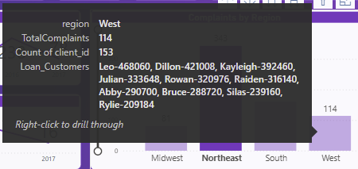
New Measures with Variables
TOPN
Returns the top N rows of the specified table
SELECTCOLUMNS
Returns a table with selected columns from the table and new columns specified by the DAX expressions
CONCATENATEX
Ensuring any sensitive data sources are disconnected
Notes:
This slide covers new measures with variables. TOPN returns the top N rows of a specified table. SELECTCOLUMNS returns a table with selected columns and new columns specified by DAX expressions. CONCATENATEX ensures any sensitive data sources are disconnected. Original Content: New Measures with Variables TOPN Returns the top N rows of the specified table. SELECTCOLUMNS Returns a table with selected columns from the table and new columns specified by the DAX expressions. CONCATENATEX Ensuring any sensitive data sources are disconnected

Slide 32
Row-Level Security
Setting Up Roles in Power BI
Go to the Modeling tab in Power BI Desktop
Select Manage Roles and create a new role
Assign a name to the role
Defining the DAX Filter
Create a DAX expression to control data access
Use LOOKUPVALUE and USERPRINCIPALNAME functions
Applying Row-Level Security for Specific Tables
Testing Row-Level Security
Publishing and Assigning Roles
Advanced RLS with Multiple Filters
Best Practices for Row-Level Security
Notes:
Row-Level Security in Power BI restricts data access based on user roles. Set up roles, define DAX filters, apply RLS to specific tables, test the setup, publish and assign roles, and use advanced filters. Follow best practices for effective RLS implementation. Original Content: Row-Level Security Row-Level Security (RLS) in Power BI restricts the data that users can view based on their roles. It allows businesses to control which subset of data a specific user or group of users can access within a dataset. This is especially useful for organizations dealing with sensitive information, multiple regions, or different departments requiring segmented access to data. Table Structure Overview For this example, we'll use the following tables from the dataset provided: Customer Table: Client_ID District_ID Age_Category Zipcode Order Table: Order_ID Client_ID Category_ID Product_Name Sales Profit District Table: District_Code Region State_Name The main goal of RLS is to restrict users to see only the data related to their assigned region, district, or department. Step 1: Setting Up Roles in Power BI In Power BI Desktop, go to the Modeling tab. Select Manage Roles. Click Create to define a new role. Assign a name to the role, such as "District Manager" or "Regional Manager." In this example, we’ll set up a role to restrict data access based on the user's assigned District. Step 2: Defining the DAX Filter Now that we have created a role, we need to define the DAX expression that will control which data users can access based on their district. In the District Manager role, we'll apply a DAX filter that restricts the data shown to only the rows where the district matches the logged-in user's assigned district. We will assume that the district information is stored in the District_ID column of the Customer Table and the District_Code in the District Table. [District_Code] = LOOKUPVALUE(Customer[District_ID], Customer[Client_ID], USERPRINCIPALNAME()) Explanation: LOOKUPVALUE retrieves the District_ID from the Customer Table where the Client_ID matches the email (or another unique identifier) of the logged-in user. USERPRINCIPALNAME() is a DAX function that returns the current user's login ID or email address. The filter ensures that the user will only see data for orders in their own district. Step 3: Applying Row-Level Security for Specific Tables You can apply DAX filters for different tables based on your security requirements. For instance, if you want to restrict data access to a specific region, you can apply a filter on the Region field in the District Table. For the Regional Manager role, the DAX expression could be: [Region] = LOOKUPVALUE(District[Region], District[District_Code], Customer[District_ID]) This ensures that a regional manager only sees data related to their specific region. You can define multiple roles in the same Power BI file for different levels of security, such as District Managers, Regional Managers, or Department Heads. Step 4: Testing Row-Level Security In Power BI Desktop, go to the Modeling tab. Select View as and choose the role you created (e.g., District Manager or Regional Manager). Power BI will simulate how the report looks to a user in that role, allowing you to validate the RLS setup. Step 5: Publishing to Power BI Service and Assigning Roles Once published, go to the Workspace in Power BI Service where the dataset is published. Select the Dataset. Click on the Security tab. Assign users or groups to the corresponding roles (e.g., assign users to the District Manager or Regional Manager roles). Power BI will automatically apply the RLS to the reports, ensuring that users only see the data for their assigned role. Step 6: Advanced RLS with Multiple Filters If you need more complex RLS scenarios, you can combine multiple conditions in your DAX expression. For example, if you want to filter by both District and Age_Category, you can extend the DAX expression as follows: [District_Code] = LOOKUPVALUE(Customer[District_ID], Customer[Client_ID], USERPRINCIPALNAME()) && [Age_Category] = "Senior" This expression limits the data for users in a specific district who belong to the "Adult" age category. Best Practices for Row-Level Security Use USERPRINCIPALNAME() to Identify Users: This function is commonly used to map logged-in users to their respective data, ensuring secure and dynamic filtering. Avoid Hardcoding: Instead of hardcoding values (e.g., District IDs or Client names), always rely on dynamic filters, such as LOOKUPVALUE, for scalability and ease of maintenance. Test RLS Thoroughly: Use the View As functionality in Power BI Desktop to test the roles. This ensures that each user sees only the data they are supposed to. Role-Based Design: Consider the business structure and design your roles based on logical groupings like departments, regions, or hierarchical levels (e.g., regional managers vs. district managers). Review and Audit RLS Assignments: Periodically review role assignments in Power BI Service to ensure that users have the correct access and that security protocols are followed.

Slide 33
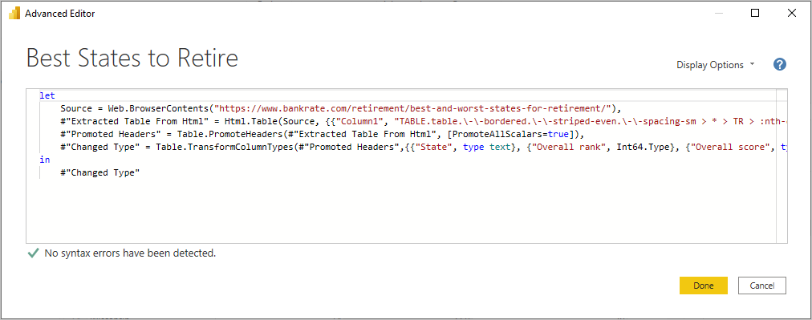
Data Transformation using Power Query
Transform Tab
Adding or removing columns
Changing data types
Splitting columns
Applying Python or R Scripts to the Data
Parse XML or JSON Files
Query Settings
Records every action or step performed on the data
Add Column Tab
Use Case 1
Use Case 2
Case 3
Notes:
Power BI's Power Query Editor offers over 300 data transformations. The Transform tab handles tasks like adding columns and changing data types. Query Settings record actions and allow rollbacks. The Add Column tab helps with column tasks. Use cases include combining Excel sheets and files, and downloading temperature data. Original Content: Data Transformation using Power Query The "Transform Data" option in Power BI opens the Power Query Editor. As of May 2023, Microsoft's official documentation states that over 300 different data transformations are available, and this number continues to grow! Transform Tab The Transform tab provides access to everyday data transformation tasks, such as: Adding or removing columns Changing data types Splitting columns Applying Python or R Scripts to the Data Parse XML or JSON Files Other data-driven tasks Query Settings Every action or step performed on the data is recorded in the query It allows you to roll back to a previous state. Most importantly, it applies these steps each time the data is refreshed. Add Column Tab The Add Column tab provides more tasks associated with adding a column, formatting column data, and adding custom columns. The following image shows the Add Column tab. View Tab Use Case 1 Combine and Load Multiple Excel Sheets as Single Data Set Power BI allows you to load data from multiple sheets within an Excel file, as long as they contain the same columns. Please use the provided sample data for this exercise. Download Sample Sales Data Use Case 2 Combine and Load Multiple Excel Files from a Folder Power BI allows you to load multiple files from a folder into a single dataset, provided that the files contain the same columns. Please use the sample data provided for this exercise. Download Sample Excel Files Case 3 Download Temperature Data Optionally, add metadata such as a description of the template, which will help users understand its purpose.

Slide 34
Connecting to SQL Server
Two primary methods to connect to SQL Server
Import
Direct Query
Each method has its own benefits and limitations
Suitable for different reporting and analytical needs
Guide to connecting Power BI Desktop to SQL Server
Detailed steps
Examples
Comparison of pros and cons
Notes:
Power BI Desktop offers two primary methods to connect to SQL Server: Import and Direct Query. Each method has its own benefits and limitations, suitable for different reporting needs. This chapter guides you through connecting Power BI Desktop to SQL Server using both methods, with detailed steps, examples, and a comparison of their pros and cons. Original Content: Connecting to SQL Server Power BI Desktop offers two primary methods to connect to SQL Server: Import and Direct Query. Each method has its own benefits and limitations, making them suitable for different reporting and analytical needs. This chapter will guide you through connecting Power BI Desktop to SQL Server using both methods, with detailed steps, examples, and a comparison of their pros and cons. Import Mode What is Import Mode?

Slide 35

Data Connectivity Mode: Import
Select Data Connectivity Mode
Choose Import option
Authenticate
Provide necessary credentials
Select Tables or Views
Choose the data you want to import
Load Data
Click Load to import data into Power BI
Sample SQL Query for Import Mode
SELECT ProductID, ProductName, SUM(SalesAmount) AS TotalSales FROM Sales GROUP BY ProductID, ProductName
Notes:
To import data into Power BI, select the Data Connectivity Mode and choose Import. Authenticate with your credentials, select the tables or views to import, and click Load. A sample SQL query for Import Mode is provided. Original Content: In the Data Connectivity Mode, select Import. Click OK. You’ll be prompted to authenticate: Once authenticated, select the tables or views you want to import into Power BI. Click Load to import the data into Power BI. // Sample SQL Query for Import Mode SELECT ProductID, ProductName, SUM(SalesAmount) AS TotalSales FROM Sales GROUP BY ProductID, ProductName

Slide 36

Benefits of Import Mode
Performance
Data is loaded into Power BI’s in-memory engine
Queries and transformations are very fast
Offline Access
Data can be imported
Work offline without needing a live connection to the SQL Server
Complex Transformations
Power BI’s DAX and M query engine
Perform complex calculations and aggregations on imported data
Notes:
Power BI offers several advantages. Its in-memory engine ensures fast queries and transformations. Once data is imported, you can work offline without a live SQL Server connection. Additionally, Power BI’s DAX and M query engine allows for complex calculations and aggregations on imported data. Original Content: Performance: Since data is loaded into Power BI’s in-memory engine, queries and transformations are very fast. Offline Access: Once data is imported, you can work offline without needing a live connection to the SQL Server. Complex Transformations: Power BI’s DAX and M query engine can perform complex calculations and aggregations on imported data.

Slide 37
Limitations of Import Mode
Data Size Issues
Importing large datasets can lead to file size problems
Complex models can cause slow performance
Refresh Time Challenges
Data needs manual or scheduled refresh
Ensuring data stays up-to-date
Notes:
Importing large datasets can cause file size issues and slow performance, especially with complex models. Additionally, data needs to be refreshed manually or on a scheduled basis to stay up-to-date. Original Content: Data Size: Importing large datasets can lead to file size issues and slow performance, especially with complex models. Refresh Time: Data needs to be refreshed manually or on a scheduled basis to stay up-to-date.

Slide 38

Direct Query Mode
Definition of Direct Query Mode
Power BI does not store data locally
Sends queries to SQL Server each time you interact with the report
Results are returned in real-time
Data is always up-to-date
Steps to Connect to SQL Server in Direct Query Mode
Notes:
Direct Query Mode in Power BI ensures real-time data by sending queries to SQL Server each time you interact with the report. This mode does not store data locally, keeping your data always up-to-date. Original Content: Direct Query Mode What is Direct Query Mode? In Direct Query Mode, Power BI does not store the data locally. Instead, it sends queries to the SQL Server each time you interact with the report. The results are returned in real-time, ensuring that your data is always up-to-date. Steps to Connect to SQL Server in Direct Query Mode

Slide 39

SQL DATA for Direct Query Mode
SELECT Statement
Retrieves OrderDate and counts OrderID as TotalOrders
FROM Clause
Specifies the Orders table
WHERE Clause
Filters results for CustomerID 123
GROUP BY Clause
Groups results by OrderDate
Notes:
This slide presents a sample SQL query for Direct Query Mode. The query retrieves OrderDate and counts OrderID as TotalOrders from the Orders table, filters results for CustomerID 123, and groups results by OrderDate. Original Content: // Sample SQL Query for Direct Query Mode SELECT OrderDate, COUNT(OrderID) AS TotalOrders FROM Orders WHERE CustomerID = 123 GROUP BY OrderDate

Slide 40

Benefits of Direct Query Mode
Real-Time Data
Queries are run directly on the SQL Server
Data is always current without manual refreshes
Large Data Sets
Handles larger datasets
Data is queried from the SQL Server, not loaded into Power BI
Notes:
Direct Query in Power BI offers real-time data by running queries directly on the SQL Server, ensuring data is always current. It also handles larger datasets efficiently, as data is queried from the SQL Server rather than being loaded into Power BI. Original Content: Real-Time Data: Since queries are run directly on the SQL Server, data is always current, without the need for manual refreshes. Large Data Sets: Direct Query can handle larger datasets since data is not loaded into Power BI, but is queried from the SQL Server.

Slide 41
Limitations of Direct Query Mode
Criteria | Import Mode | Direct Query Mode
Data Size | Best for small to medium datasets (up to ~1GB). | Best for large datasets where you want to avoid loading data into memory.
Performance | Fast queries and transformations using in-memory data. | Query performance depends on SQL Server response time.
Data Freshness | Data is static until manually refreshed. | Always provides the most up-to-date data from SQL Server.
Offline Access | Can work offline once data is imported. | Requires a continuous connection to SQL Server.
Complex Transformations | Supports advanced DAX and M transformations. | Limited transformations available, many DAX functions not supported.
Performance Issues
Query performance depends on the SQL Server
Complex queries or large datasets may result in slower response times
Limited Transformations
Not all DAX functions and transformations are supported in Direct Query mode
SQL Server Load
Every interaction with the report sends a query to SQL Server
Can lead to high server load
Notes:
Direct Query mode has limitations such as performance issues, limited transformations, and high SQL Server load. Complex queries or large datasets can slow down response times, not all DAX functions are supported, and frequent interactions can lead to high server load. Original Content: Performance: Query performance depends on the SQL Server. Complex queries or large datasets may result in slower response times. Limited Transformations: Not all DAX functions and transformations are supported in Direct Query mode. SQL Server Load: Every interaction with the report sends a query to SQL Server, which can lead to high server load.

Slide 42
Using Native Queries
Purpose of NativeQuery
Execute custom SQL queries directly against a data source
Comes with certain benefits
Syntax for NativeQuery
Value.NativeQuery(Sql.Database("serverName", "databaseName"), "SELECT * FROM order WHERE Segment = 'Consumer'",[EnableFolding=true])
Notes:
NativeQuery in Power Query Editor allows executing custom SQL queries directly against a data source, offering certain benefits. The syntax for NativeQuery is provided for reference. Original Content: Using Native Queries The purpose of using NativeQuery in Power Query Editor is to execute custom SQL queries directly against a data source. It comes with certain benefits. Syntax for NativeQuery Value.NativeQuery(Sql.Database("serverName", "databaseName"), "SELECT * FROM order WHERE Segment = 'Consumer'",[EnableFolding=true])

Slide 43

Connecting to OneDrive
Connecting to OneDrive
Sync reports with cloud-based data files
Seamless integration with Excel, CSVs, and Power BI datasets
Steps to Connect Power BI Desktop to OneDrive
Example: Connecting to an Excel File on OneDrive
Track sales data in an Excel file on OneDrive
Create visualizations in Power BI using this data
Benefits of Connecting to OneDrive
Limitations of Connecting to OneDrive
Best Practices
Notes:
Power BI Desktop can connect to OneDrive, syncing reports with cloud-based data files. This chapter covers steps to connect, an example with an Excel file, benefits, limitations, and best practices. Original Content: Connecting to OneDrive Power BI Desktop can connect directly to files stored in OneDrive, allowing you to sync your reports with data stored in the cloud. This feature enables seamless integration between Power BI and cloud-based data files, such as Excel workbooks, CSVs, and Power BI datasets, providing a convenient way to keep your data updated in Power BI. This chapter will provide step-by-step instructions to connect Power BI Desktop to OneDrive, with examples and a comparison of the benefits and limitations of this approach. Steps to Connect Power BI Desktop to OneDrive Example: Connecting to an Excel File on OneDrive Let's say you have an Excel file on OneDrive that tracks sales data. You want to use this data to create visualizations in Power BI. Follow these steps: Benefits of Connecting to OneDrive Limitations of to OneDrive Best Practices

Slide 44
Connecting to an API
Steps to Connect to an API
Follow step-by-step instructions
Example: Connecting to a REST API for Weather Data
Benefits of Connecting to an API
Access real-time data from various sources
Integrate external data into Power BI reports
Limitations of Connecting to an API
Potential data latency issues
API rate limits and access restrictions
Best Practices for API Integration
Ensure API reliability and stability
Monitor and handle API errors effectively
Notes:
Connecting Power BI Desktop to an API allows you to leverage external data. Follow step-by-step instructions to connect, such as using a REST API for weather data. Benefits include accessing real-time data and integrating it into reports. However, be aware of limitations like data latency and API rate limits. Follow best practices for reliable integration. Original Content: Connecting to an API Connecting Power BI Desktop to an API allows you to leverage data from external web services and integrate it into your reports. APIs (Application Programming Interfaces) are widely used to access real-time data from different sources like web applications, cloud services, and databases. This chapter provides step-by-step instructions for connecting Power BI Desktop to an API, offering examples, benefits, and limitations of this approach. Steps to connect to an API Example: Connecting to a REST API for Weather Data Suppose you want to pull weather data into Power BI using a REST API from a weather service. Here's how you can connect: Benefits Limitations Best Practices

Slide 45
Changing the Data Source in Power BI
Flexibility of Power BI
Connects to various data sources
Allows switching data sources without losing work
Reasons to Change Data Source
Need for updated or different data
Data source no longer available
Performance improvements
Steps to Change Data Source
Detailed instructions provided
Maintains transformations, measures, and visualizations
Benefits and Limitations
Flexibility in data management
Notes:
Power BI offers flexibility in connecting to various data sources. You may need to switch data sources for updated data, unavailable sources, or performance improvements. This chapter provides detailed instructions on changing data sources while maintaining transformations, measures, and visualizations, along with the benefits and limitations of this process. Original Content: Changing the Data Source in Power BI One of the key strengths of Power BI is its flexibility in connecting to various data sources. At times, you may need to switch your data source without losing the work you've already done, such as the transformations in Power Query, measures in DAX, or the visualizations you’ve built. This chapter will guide you through the process of changing the data source in Power BI, provide detailed instructions, and explain the benefits and limitations. Reasons to Change the Data Source There are several reasons why you might need to change the data source in Power BI: Steps to Change the Data Source in Power BI

Slide 46

Project
Training Sessions Details
Includes dates, client information, and financial details
Lists columns such as Training Date, Client, Course, Location, Revenue, and Trainer
Logistics and Financial Aspects
Details on number of sessions and students
Hourly rates and payment dates
Notes:
The file provides a comprehensive overview of training sessions, including dates, client info, and financial details. It lists columns like Training Date, Client, Course, Location, Revenue, and Trainer, along with logistics and financial aspects. Original Content: Project Project Description The file contains details about various training sessions organized by the business called "The Training Company", including the dates, client information, and financial details. It lists columns such as Training Date, Client, Course, Location, Revenue, and Trainer, indicating when and where the training sessions occurred, who conducted them, and how much revenue they generated. Additional details include the number of sessions and students, hourly rates, payment dates, providing a comprehensive overview of each training session's logistics and financial aspects. Download File Activity

